Slide 1

Manchester City Football Club Management System
Information System Management Course Project
Ly Minh Trung – ITDSIU19023
Kieu Chi Huy – ITDSIU19014
Truong Thai Ngoc Toan – ITDSIU19057
Nguyen Dao Trung Hieu – ITDSIU19035
Nguyen Anh Tuan – ITITIU19061

Slide 2
TABLE OF CONTENTS
01
Introduction
02
Implementation
03
04
Final Application
Conclusion
Overview-Reason why our project is usefull
Main fuctions – Roles – How does it work
Final Application

Slide 3
01
Introduction
You can enter a subtitle here if you need it

Slide 4

Role of Manager
•Match team selection and formation.
•Strategy and pitch instructions.
•Delegating to the first team coach and coaching and medical personnel.
•Scouting and developing young, gifted players for the youth academy or reserves.
•Player transfers
Every manager's decision is important. A minor error will have a significant effect on the squad. Consequently, this app will support in their decision-making.

Slide 5

Why choose our app?
You are a new manager just arrive
Our apps will provide you a clear picture of the statistics and assist you in choosing a team for the upcoming games.
It's transfer window
With thousands of player, we will assist you in selecting the ideal player based on your demands.
CHAMPIONS

Slide 6
02
Implementation
Manchester City FC
Squad Recommendation – Transfer Recommendation

Slide 7

Squad Recommedation Overview
01
Analysis Players
02
The coach input requirements
03
Application show Squad for next match
Using Chart to show best 10 players in each attribute
Squad – Speed – Intercept – Style – Squad Distance – Match Approach
For each posision, the application will show the ultimate selection

Slide 8
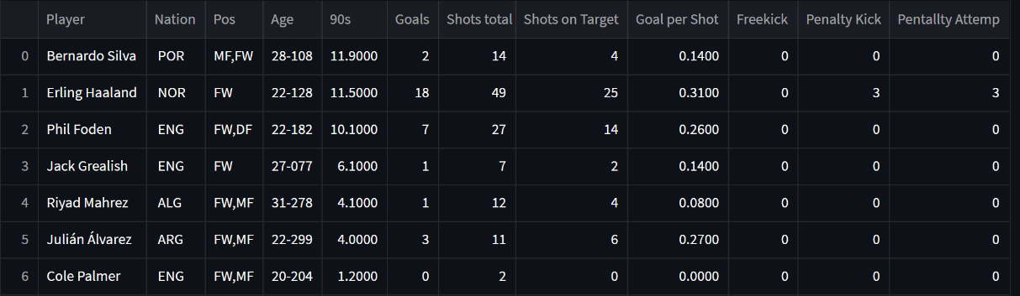
Analysis Information
From a general information sheet, select the columns corresponding to each position and filter for each player.
Ex: Stats about attacking of players can play in forward
Use a bar chart to display the most necessary information about the performance of the players(Goals, Assists, Tackles Win, Tackled, Intercept, Mistakes,…)

Slide 9
Expected Goal or Assist
The probability that a shot will result in a goal based on the characteristics of that shot and the events leading up to it.
Stats Perform’s xG/xAG model is built using a logistic regression model that is powered by hundreds of thousands of shots from our historical Opta’s data and incorporates a number of variables that affect the likelihood of a goal being scored, some of the most important of which are listed below:
Distance to the goal
Angle to the goal​
One-on-one
Big chance
Body part (e.g., header or foot)
Type of assist (e.g., through ball, cross, pull-back etc) ​
Pattern of play (e.g., open play, fast break, direct free kick, corner kick, throw-in etc)

Slide 10
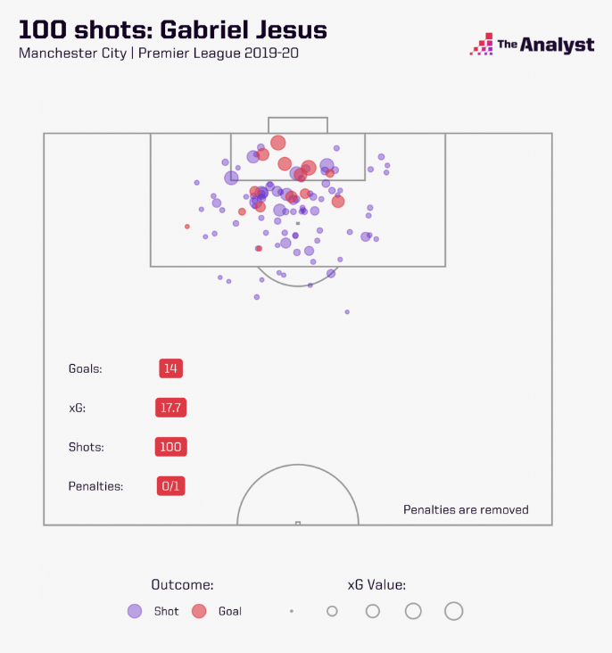
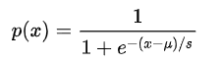
Expected Goal or Assist
Logistic regression
μ: a location parameter
S: a scale parameter

Slide 11

Opta’s xG model
Statsbomb is a leading football analytics company and provides data that is superior in quality
How is xG/xAG calculated?
Expected goals (xG) measures the quality of a shot based on several variables such as assist type, shot angle and distance from goal, whether it was a headed shot and whether it was defined as a big chance.
Expected assists (xA) measures the likelihood that a given pass will become a goal assist. It considers several factors including the type of pass, pass end-point and length of the pass.

Slide 12
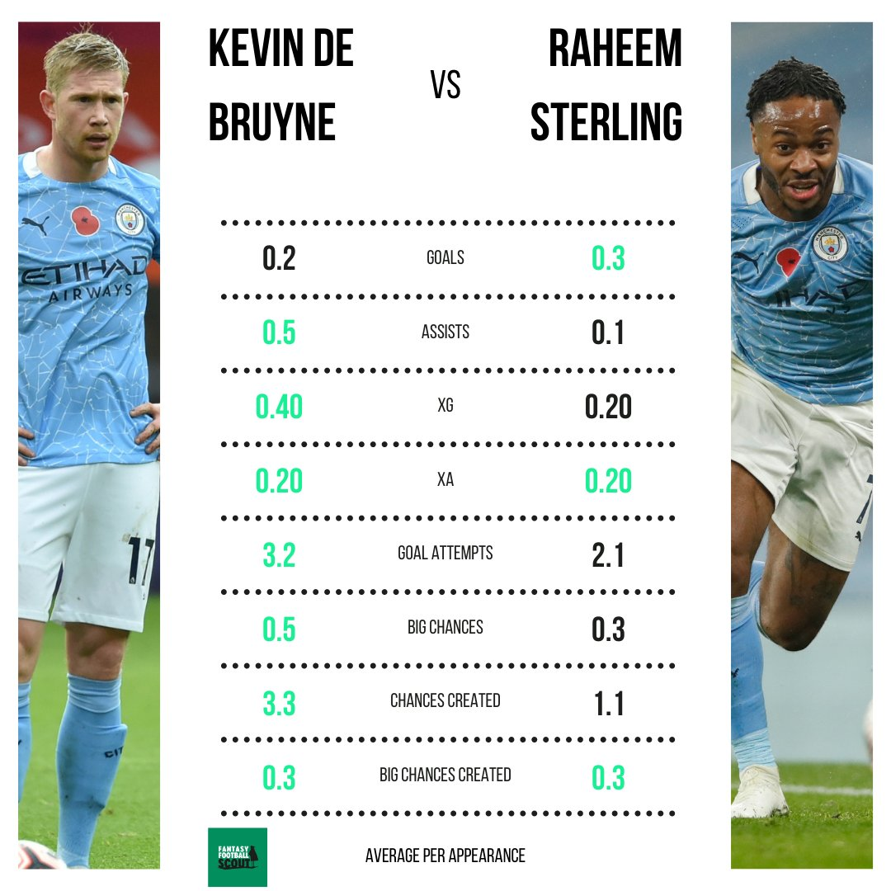
Player similarity
Based on the manager's choice of player and league that the replacement player should come from
Using the Cosine similarity to find list of players that match the criteria since Cosine similarity allows us to better capture “style” rather than pure “statistics” attributes

Slide 13
03
Functions

Slide 14
Application give recommedation
How does the application give the recommendation?
Base on requirement of coach
Ex: Squad 4-4-2 → 4 Defensive + 4 Midfield + 2 Forward
Speed high → choose players have high attacking index
Intercept high → choose players have high Tackles and Intercept index
Match Approach Attack → Focus mainly on strikers with high xG stats, midfielders with high xAG stats, while defenders choose players with good counter-attacks (intercept/tackles win)
=> The machine will calculate based on the algorithm we built and give the most balanced lineup

Slide 15
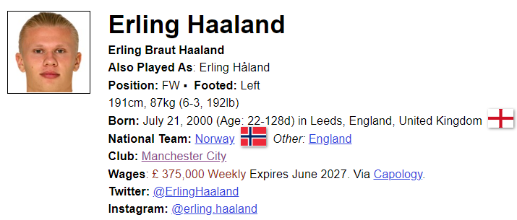
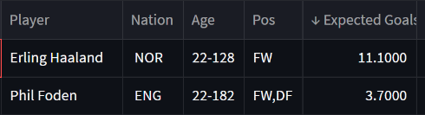
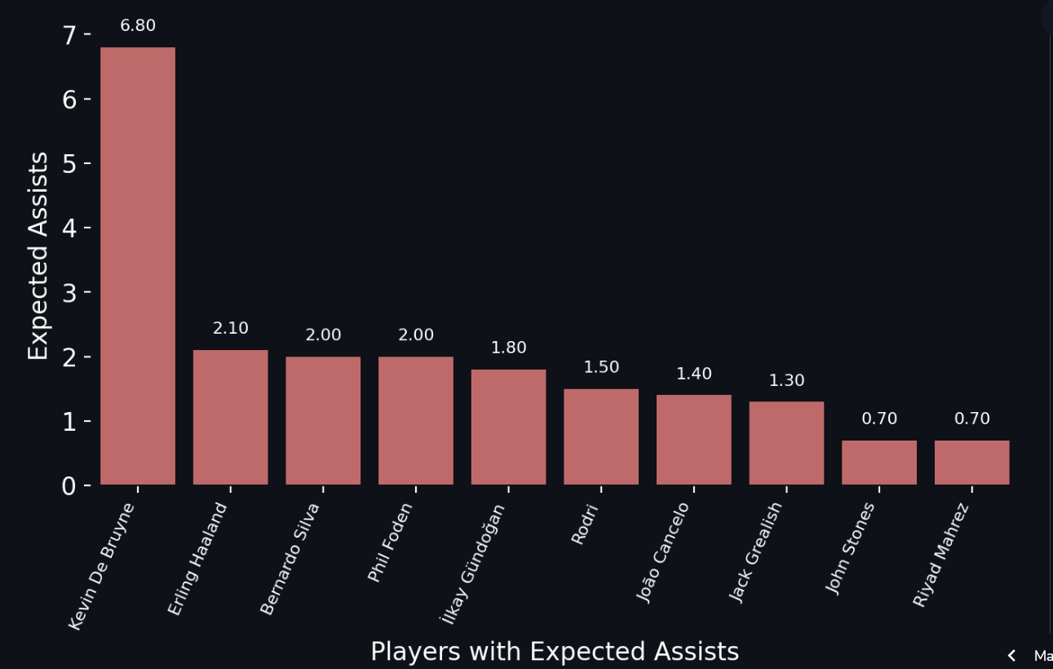
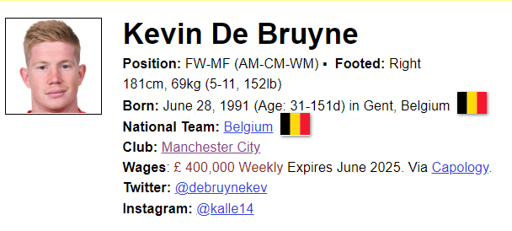
Example
Selection Forward for 4-4-2 Squad and Match Approach is Attack:
Two players have highest expected goal
Selection Midfield for 4-4-2 Squad and Match Approach is Attack:

Slide 16
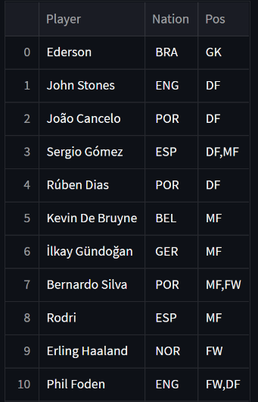
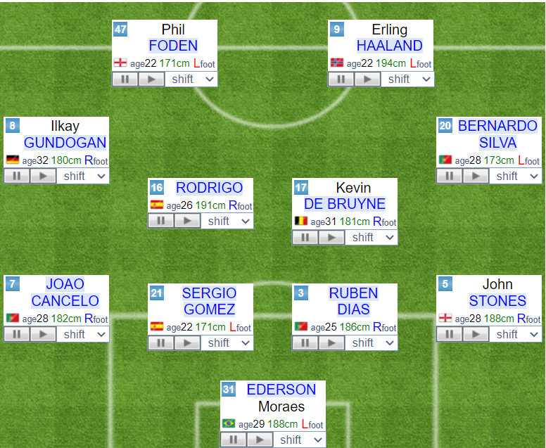
Application give recommedation
The list of 11 most suitable players for a 4-4-2 squad with attacking play from the start

Slide 17
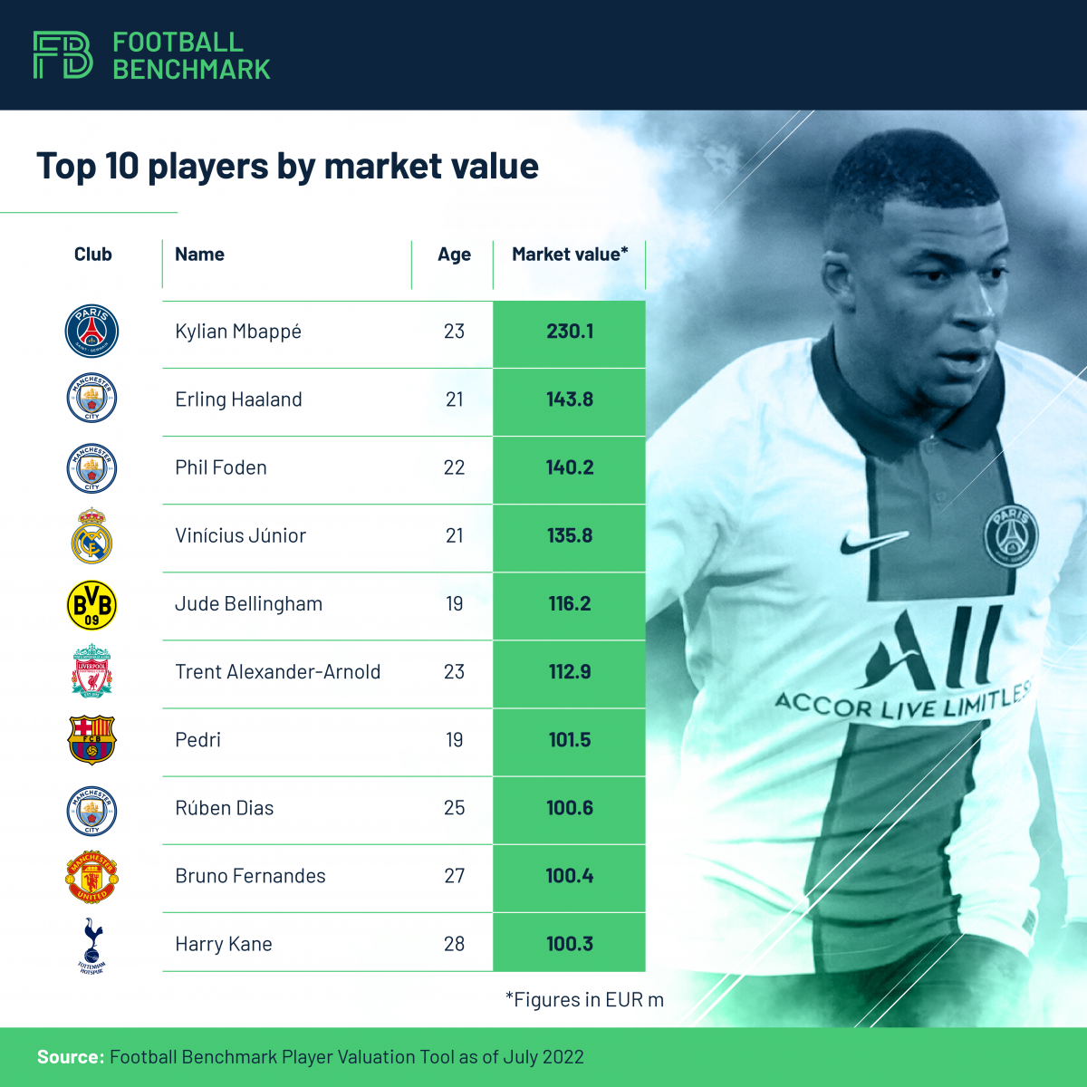
Transfer Recommendation
01
Finding Players
02
The coach's criteria for player selection
03
Player recommendation
Allow users to search the top five European leagues for players who meet their criteria.
Enabling coaches to choose players depending on roles and leagues they choose to play in
Provide a short list of players who meet the manager's requirements.

Slide 18
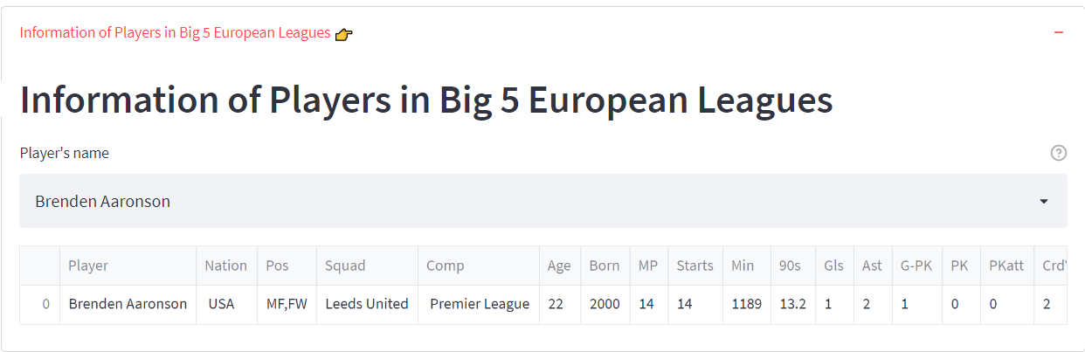
Searching player function
Our program offers the manager the ability to find a player's information from a dataset that includes data on more than 2000 players from the top five European leagues.
The manager can interact with this information by seeing the player's detailed information, as well as their statistics relating to the decision function.

Slide 19
Player recommendation function
Base on the input from the manager:
Manager will choose which player that need to be replaced
The manager will enter the league in which they are seeking for a replacement player.
Our program will take the user's input, examine the player dataset's data, and do some calculations to provide a list of 10 players that the manager should take into consideration.

Slide 20
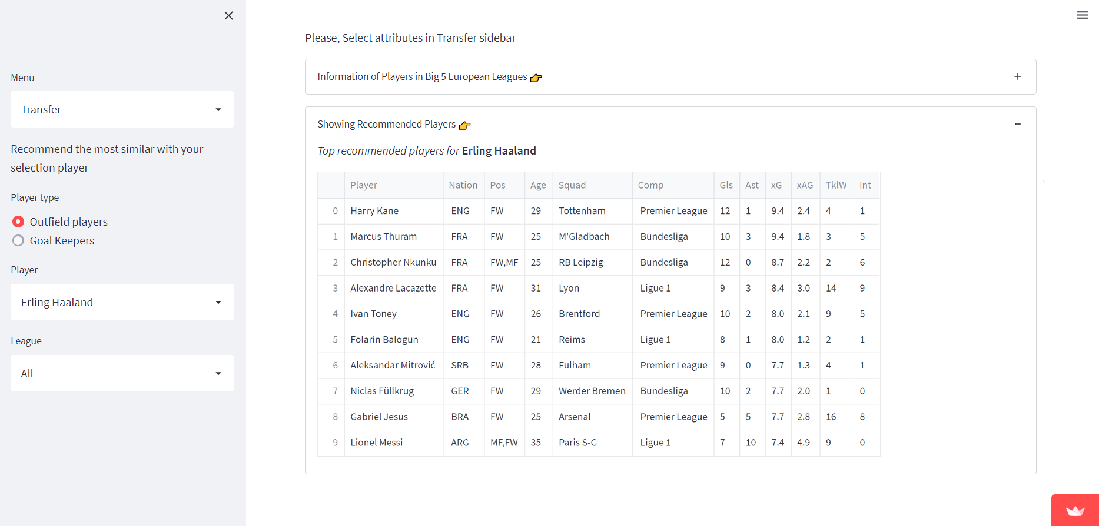
Result

Slide 21
04
Final Application
Manchester City Football Club Management Decision Support System

